Slide 1


Carpinteria Groundwater Sustainability Agency (CGSA) Public meeting
JUN 14, 2022
Notes:
I’m Bob McDonald the General Manager for the Carpinteria Valley Water District. Today I’ll be talking to you about:
The Drought, The status of the Districts water

Slide 2

What is the SGMA?
Sustainable Groundwater Management Act
  Three bill package signed into California law in late 2014
  Provides a statewide framework for long-term sustainable groundwater management in California
  Applies to “medium” & “high” priority basins, as determined by the Department of Water Resources

Slide 3
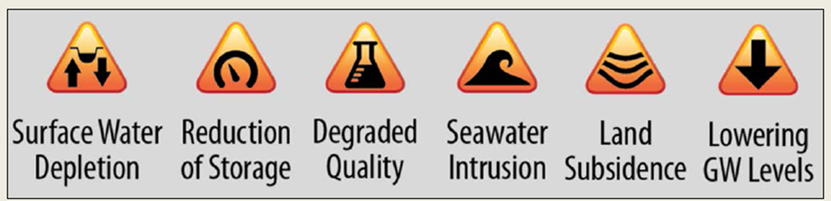
SGMA’s Goal is…
Sustainable Groundwater Management
Sustainable GW Management = Avoiding “Undesirable Results”
SGMA definition of “Undesirable Results”

Slide 4

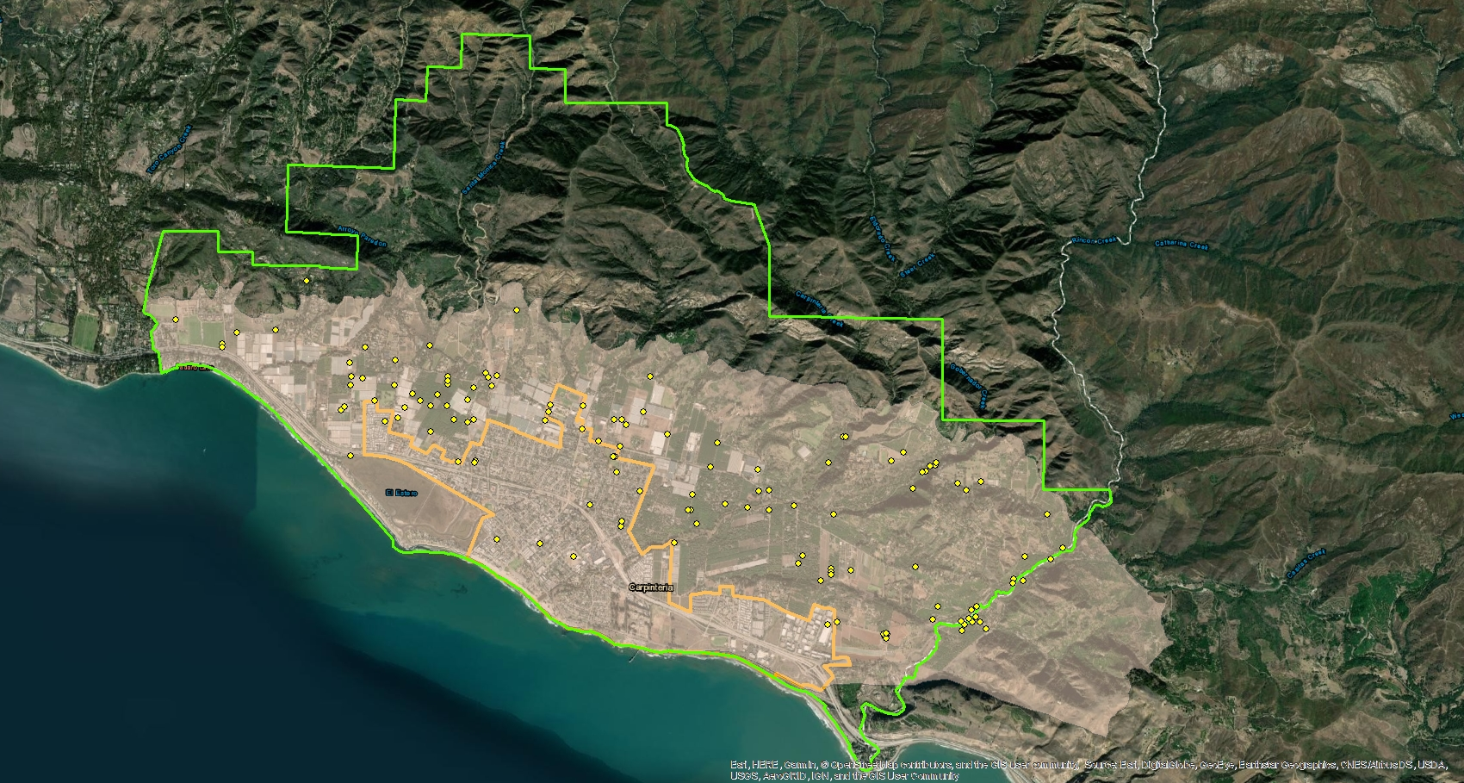
Where is Carpinteria Groundwater Basin (CGB)?
Santa Barbara County
Ventura County
Carpinteria Groundwater Basin
Pacific Ocean

Slide 5
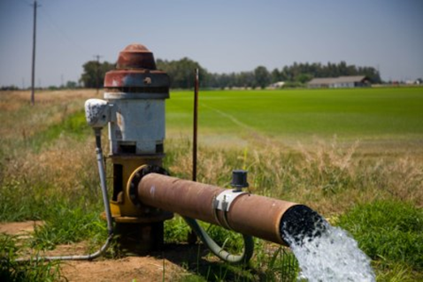
Why is Managing Groundwater important for Carpinteria Valley?
The local groundwater resource provides around 25% of Carpinteria Valley Water District’s water supply annually.
The local groundwater resource provides about 2/3 of water pumped for private agriculture in Carpinteria Valley and portions of Ventura County.
Groundwater provides benefits to the ecosystem in Carpinteria.

Slide 6
What Does SGMA Require of
High & Medium Priority Basins?
Form a Groundwater Sustainability Agency (GSA)
  Within 2 years after basin prioritization. (2019)
Adopt a Groundwater Sustainability Plan (GSP)
  No More than 5 years after basin reprioritization (2024)
Achieve Sustainable Groundwater Management
  20 years following GSP adoption (2044)
State will intervene if local agency implementation fails

Slide 7




Carpinteria Groundwater Basin under SGMA
  Background;
  Carpinteria Basin was designated High Priority by State in 2019
    -Due to importance of groundwater in Carpinteria Valley
  Carpinteria GSA (CGSA) was formed in 2020 through a Joint Powers Authority Agreement (JPA).
  Carpinteria GSA is a separate agency from CVWD.
CARPINTERIA GSA MEMBERS

Slide 8
Carpinteria Groundwater Basin under SGMA
GSA Responsibilities?
Develop, adopt, and implement a GSP to achieve sustainable groundwater management withing 20 years.
Groundwater monitoring and annual reporting to DWR
Review and update GSP every 5 years
Continued Stakeholder outreach and engagement
Implement Management Actions, if necessary to achieve sustainability

Slide 9
Carpinteria Groundwater Basin under SGMA
Funding?
  GSP development is primarily funded through a State grant program ($1.9M)
  GSA Operations funded using loans from CVWD for FY 21 & FY 22
  GSA Fee being developed to support ongoing GSA operations

Slide 10
Carpinteria Groundwater Basin under SGMA
What else is happening under SGMA in Carpinteria?
  A grant for $1.9M was awarded to CVWD on behalf of CGSA to prepare a GSP for the Basin
  GSA is installing new monitoring wells under the Grant program
  GSA is monitoring Coastal Wells for Seawater intrusion
  GSP is in development and will be completed near the end of 2023
  GSA will be implementing a revenue collection system starting FY23

Slide 11

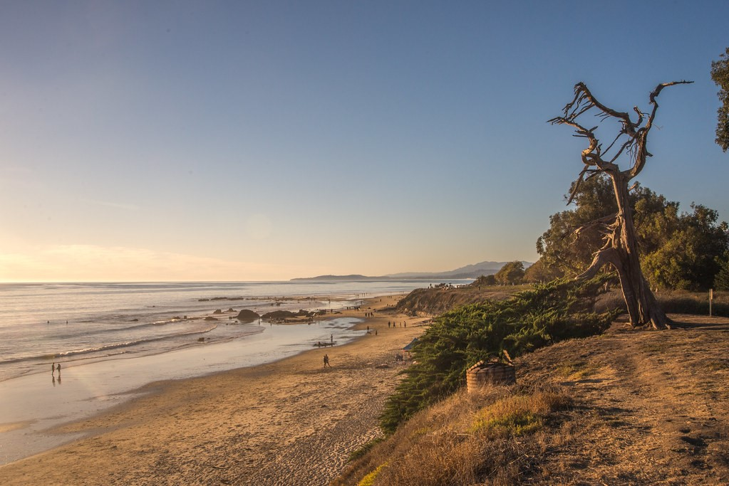
Carpinteria GSA
GSA Fee Study
Community Meeting
June 14, 2022
This Photo
by Unknown Author is licensed under
CC BY
-NC

Slide 12
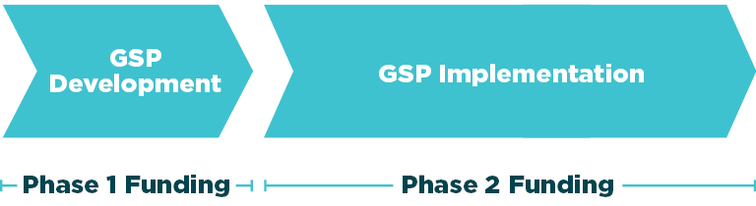
Sustainable Groundwater Management Act (SGMA) Timeline and Funding Phases

Slide 13

Fee Study Process
1
2
3
4
Framework
  Pricing and policy objectives
  Fee structure evaluation
Financial Plan
  Cash flow analysis
  Scenario analyses
Fee Design
    Fee structure evaluation
    Fee calculations
Adoption
  Documentation
  Public Notice
  Public Hearing

Slide 14
Fee Study – Primary Questions
Who should pay?
How should we structure the fee?
How should we adopt the fee?
How much will this cost?

Slide 15
Fee Structure Evaluation
Policy Objective | All Parcels | Non-de minimis Parcels | Total Acreage | Irrigated Acreage | Est. Gross Pumping | Est. Net Pumping
Administration
Equity
Financial Stability
Affordability
?
?
= Least
= Best

Slide 16
Fee Proposal
All parcels overlying the groundwater basin will be subject to the proposal
  Some land uses are exempted from the GSA’s fee calculation
    Examples: federal lands and public easements and rights of way
Proposed charge is based on a parcel’s acreage
Charges would be billed using the Counties’ direct charge authority
  Parcels would pay GSA charges on their property tax statement, twice per year

Slide 17
Five-Year Financial Plan
Basis for costs is FY 2022 (current year) budget
Future year costs escalated based on inflationary assumptions and adjustments for one-time expenses
CVWD loan reimbursement over three years
Reserve funding over four years
  Target of six months cash on hand
Primary costs to be recovered include: personnel, groundwater professional services, water quality testing, legal, and administration
Total costs of approximately $350,000 per year the first three years
Cost of developing the Groundwater Sustainability Plan (GSP) is funded through a state grant

Slide 18
Acreage Calculation
Parcel acreage that will be subject to proposed charges was calculated from the total area within the Groundwater Basin Boundary
  Any parcel portion outside of the hydrological basin boundary was removed from total acreage
  Only the portion inside the basin boundary will be subject to charges

Slide 19
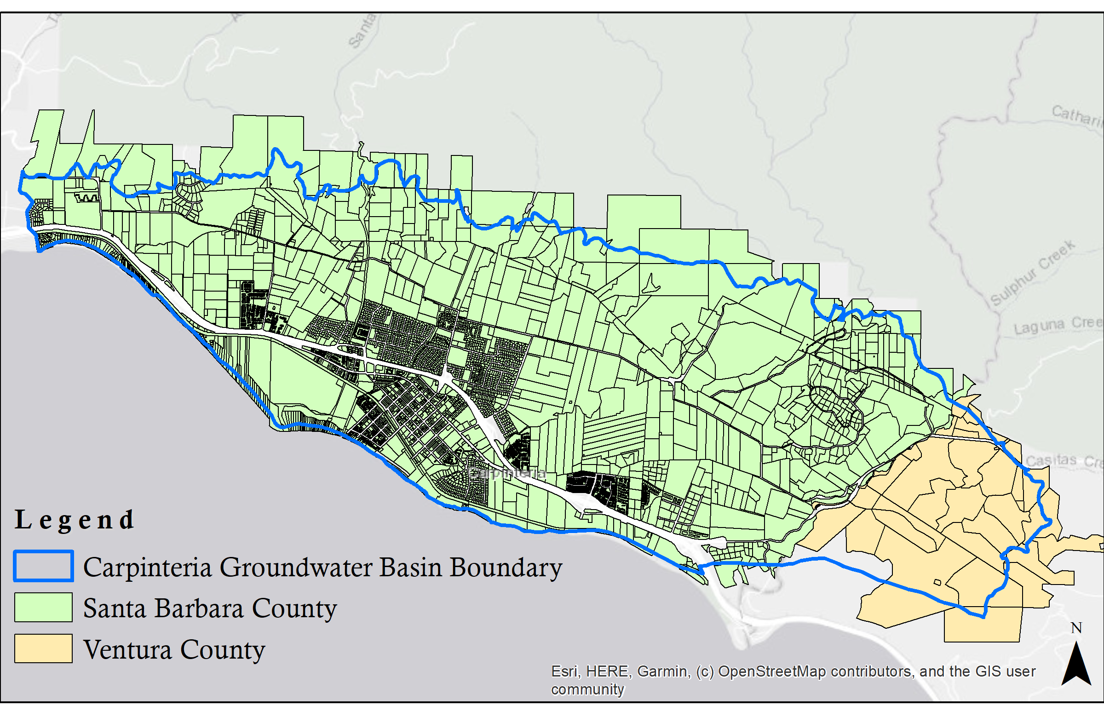
All Intersecting Acreage

Slide 20
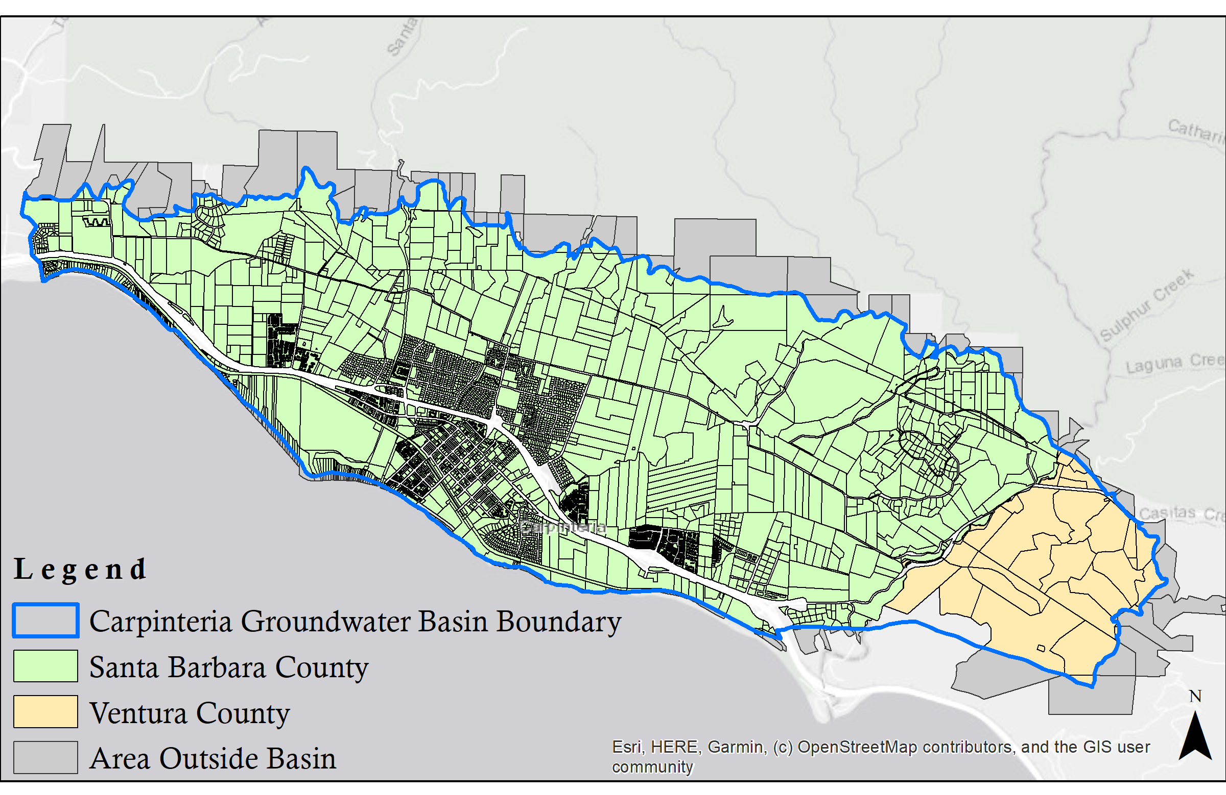
Net Acreage (grey shaded area removed)

Slide 21
Other Acreage Excluded / Omitted
Total acreage removed from fee calculation: 44 acres
  Parcels that are not currently and cannot reasonably be developed in the future are omitted from the fee calculation
    Examples: rights of way and conservation easements
  Federal or tribal lands (exempt from SGMA)
  All other parcels are included for purposes of the fee calculation
If no property tax statement is generated by the counties, the GSA will need to attempt to directly bill the properties
    Examples: Low value / $0 parcel, tax exempt classification

Slide 22
Net Acreage (subject to GSA Fee)
 | Acreage
Gross Acreage Intersecting the Basin Boundary | 8,836
(Less Parcel Acreage Outside the Basin Boundary) | (1,420)
Net Acreage within the Basin Boundary | 7,416
(Less Exempted/Omitted Acreage) | (44)
Net Acreage subject to GSA Fees | 7,372

Slide 23
Proposed Fees ($/Acre)
Five-year fee projection shown
Proposal is for a three-year adoption
  Adopted through the estimated Groundwater Sustainability Plan (GSP) implementation year
  Fee to be revisited once any projects and management action costs are identified
Fee Calculations | FY 2023 | FY 2024 | FY 2025 | FY 2026 | FY 2027
Fee per Acre per Year | $48.00 | $49.00 | $49.00 | $32.00 | $29.00

Slide 24
Fee Impacts (Year 1), by Parcel Size
Parcel Size (Acres) | Fee ($/Yr) | Fee ($/Installment)
1/8 Acre | $6.00 | $3.00
1/5 Acre | $9.60 | $4.80
1/4 Acre | $12.00 | $6.00
1/2 Acre | $24.00 | $12.00
3/4 Acre | $36.00 | $18.00
1 Acre | $48.00 | $24.00
2 Acres | $96.00 | $48.00
5 Acres | $240.00 | $120.00
10 Acres | $480.00 | $240.00
25 Acres | $1,200.00 | $600.00
50 Acres | $2,400.00 | $1,200.00
  90th percentile SFR: 1 acre 90th percentile Agriculture: 25 acres

Slide 25
Fee Implementation
Fees effective
The first charges
Total charges
If parcel (APN) acreage is within the Basin
Charges will be split
July 1 (beginning of the County and Carp GSA fiscal year)
Would show on fall property tax statements as a new “fixed charge” for the Carp GSA
Based on parcel acreage, or fraction thereof
It will be charged unless one of the exempted categories
Between fall and spring tax statements (half each)

Slide 26
Summary
The fees recover the costs of administration and operations for the Carp GSA
Any additional funding for Projects and Management Actions (PMAs) will be determined separately after GSP adoption and approval
Most common Single Family Residential property (around 1/5 acre) will see an annual charge of approximately $9
Most common Agricultural property (around 8 acres) will see an annual charge of approximately $372

Slide 27
Next
Proposed Board Adoption on June 29
Submission of charges to Counties July to August
First charges received in Fall of 2022

Slide 28


Contacts:
Kevin Kostiuk
213 262 9309 / kkostiuk@raftelis.com
Lindsay Roth
213 262 9313 / lroth@raftelis.com
Gina DePinto
213 262 9314 / gdepinto@raftelis.com

Slide 29
Additional Slides

Slide 30
Inflationary Assumptions
Inflationary Assumptions | FY 2023 | FY 2034 | FY 2025 | FY 2026 | FY 2027
General | 5.00% | 3.00% | 3.00% | 3.00% | 3.00%
Salary/COLA | 2.00% | 2.00% | 2.00% | 2.00% | 2.00%
Salary/Employee Menefits | 6.00% | 6.00% | 6.00% | 6.00% | 6.00%
Electricity | 4.00% | 4.00% | 4.00% | 4.00% | 4.00%
No Escalation | 0.00% | 0.00% | 0.00% | 0.00% | 0.00%
Reserve Interest | 1.25% | 1.25% | 1.25% | 1.25% | 1.25%

Slide 31
Five-Year Financial Plan
Expenses | FY 2021 | FY 2022 | FY 2023 | FY 2034 | FY 2025 | FY 2026 | FY 2027
 | Actuals | Budget | Projected | Projected | Projected | Projected | Projected
Personnel | $55,270 | $40,000 | $40,800 | $41,616 | $42,448 | $43,297 | $44,163
Temporary Labor | $0 | $0 | $0 | $0 | $0 | $0 | $0
Water Quality Testing | $8,085 | $10,000 | $10,500 | $10,815 | $11,139 | $11,474 | $11,818
Annual Reporting | $0 | $6,500 | $6,825 | $7,030 | $7,241 | $7,458 | $7,682
Directors Fees | $0 | $3,000 | $3,150 | $3,245 | $3,342 | $3,442 | $3,545
Equipment | $0 | $2,500 | $2,625 | $2,704 | $2,785 | $2,868 | $2,954
Groundwater Professional Services | $42,165 | $50,000 | $52,500 | $54,075 | $55,697 | $57,368 | $59,089
Legal Professional Services | $560 | $10,000 | $10,500 | $10,815 | $11,139 | $11,474 | $11,818
Administrative Professional Services | $754 | $37,000 | $38,850 | $40,016 | $41,216 | $42,452 | $43,726
Administrative Expense | $1,318 | $1,700 | $1,785 | $1,839 | $1,894 | $1,951 | $2,009
County Direct Charge Fees |  |  | $5,300 | $5,300 | $5,300 | $5,300 | $5,300
Contingency |  |  | $16,754 | $17,215 | $17,690 | $18,178 | $18,680
Total Expenses | $108,152 | $160,700 | $189,589 | $194,668 | $199,892 | $205,262 | $210,785
Reimbursement to CVWD |  |  | $133,333 | $133,333 | $133,333 | $0 | $0
Annual Reserve Funding |  |  | $25,658 | $26,348 | $27,058 | $27,788 | $0
Annual Revenue Requirement (Costs) |  |  | $348,580 | $354,350 | $360,283 | $233,050 | $210,785

Slide 32
Annual Fee Impact (Year 1), by Size Category
Parcel Size (Acres) | SFR | MFR | Agriculture | Commercial | Industrial | Institution | Vacant | Misc. | N/A
Very Small | $5.82 | $1.14 | $48.67 | $4.25 | $4.45 | $2.29 | $2.40 | $2.88 | N/A
Small | $7.20 | $2.12 | $192.00 | $6.72 | $19.92 | $9.23 | $6.24 | $9.29 | N/A
Median | $8.64 | $2.76 | $372.00 | $16.80 | $72.77 | $32.72 | $14.46 | $34.60 | $123.11
Large | $12.00 | $3.53 | $677.28 | $55.20 | $372.19 | $105.86 | $52.94 | $123.60 | N/A
Very Large | $48.00 | $7.46 | $1,209.02 | $157.97 | $538.70 | $298.69 | $179.76 | $425.47 | N/A
Max | $1,610.40 | $1,085.83 | $6,553.92 | $5,889.60 | $1,050.72 | $1,806.72 | $5,436.48 | $847.20 | $217.80
Average | $24.58 | $6.92 | $563.46 | $88.42 | $203.46 | $132.81 | $101.52 | $117.74 | $123.11

Slide 33
Fee Acreage – Land Use Classifications
Raftelis consolidated county land use codes to summarize similar classifications
Summary Statistics | Total | SFR | MFR | Agriculture | Commercial | Industrial | Institution | Vacant | Misc. | N/A
Unique Parcel Count | 5,342 | 2,438 | 1,927 | 404 | 278 | 20 | 42 | 156 | 75 | 2
Carpinteria GSA Acreage | 7,372 | 1,249 | 277 | 4,613 | 512 | 85 | 116 | 326 | 189 | 5
Average Size (Acres) | 1.38 | 0.51 | 0.14 | 11.42 | 1.84 | 4.24 | 2.77 | 2.09 | 2.52 | 2.56

Slide 34
Land Classifications Statistics
Parcel size in acres by percentile, maximum, and average
Parcel Size (Acres) | Percentile | SFR | MFR | Agriculture | Commercial | Industrial | Institution | Vacant | Misc. | N/A
Very Small | 10% | 0.12 | 0.02 | 1.01 | 0.09 | 0.09 | 0.05 | 0.05 | 0.06 | N/A
Small | 25% | 0.15 | 0.04 | 4.00 | 0.14 | 0.42 | 0.19 | 0.13 | 0.19 | N/A
Median | 50% | 0.18 | 0.06 | 7.75 | 0.35 | 1.52 | 0.68 | 0.30 | 0.72 | 2.56
Large | 75% | 0.25 | 0.07 | 14.11 | 1.15 | 7.75 | 2.21 | 1.10 | 2.58 | N/A
Very Large | 90% | 1.00 | 0.16 | 25.19 | 3.29 | 11.22 | 6.22 | 3.75 | 8.86 | N/A
Max |  | 33.55 | 22.62 | 136.54 | 122.70 | 21.89 | 37.64 | 113.26 | 17.65 | 4.54
Average |  | 0.51 | 0.14 | 11.74 | 1.84 | 4.24 | 2.77 | 2.11 | 2.45 | 2.56
Notes:
Median SFR parcel is 0.18 acres, average SFR parcel is .51 acres

Slide 35
Fee versus Tax
Proposition 26: Everything is a tax under the California Constitution Article XIII C, section 1, except:
    Fees for benefits and privileges (parking permits)
    Fees for service or products (wholesale water)
    Reasonable regulatory fee (building permits)
    Fee for use of government property (park entrance fees)
    Fines and penalties (parking fines)
    Conditions of property development (capacity fees)
    Assessments and property-related fees subject to Proposition 218 (water rates)
Notes:
https://chwlaw.us/papers/prop26_new_limitations.pdf
https://www.cacities.org/Resources-Documents/Member-Engagement/Professional-Departments/City-Attorneys/Proposition-26/Proposition-26-Implementation-Guide-(April-2011)-p

